Slide 1
Thesis Presented for the Parallel Processing and Distributed System Lab
By
M. Asif Hossain
UG02-41-16-001

Slide 2
About me
Student of the State University Of Bangladesh of 41st batch
Working at Thinkrlab as a Backend developer and Lead Technical Support Engineer

Slide 3
Acknowledgements
“For guidance, support, and feedback throughout this Thesis, I would like to express my sincere gratitude to our Course Advisor Khan Md. Hasib”

Slide 4
Cover Up Topics
Introduction
Research Method
Parallel Image Processing
Discussion
Conclusion

Slide 5
Introduction

Slide 6
Research Topic
“Application of Parallel Computing Models for Image Processing in Smartphone Devices”

Slide 7
“The development and evolution of computer architectures have made parallel computation more accessible and cost-effective than ever before. The amount of created and stored information has been rapidly increasing in many areas of human life, in science and engineering, industry, medicine, and entertainment.”

Slide 8
Motivation of the Study
“The motivation for the study emerged from the author’s personal interests in image processing and the ambition to build a real-time video processing application for Apple iOS-platform iPhone, tablets, and also for the Android platform’s smartphones, tablets.”

Slide 9
Scope of the Research
The purpose was to build a real-time video effect processing application that exhaustively utilizes the GPGPU programming model on Apple iOS and Android environments. While the review of available literature seeks to be broad, specific narrowing criteria and selection is applied to limit the scope of literature to serve those aforementioned thesis.
The research question for this study is:
RQ1: What parallel computing architectures and parallel programming models are available now on mobile systems and personal mobile devices to apply complex CPU-GPU computing?

Slide 10
Research Method

Slide 11
Sources of Literature
Literature Types and Time Period
Search Process and Keywords

Slide 12
Parallel Image Processing

Slide 13
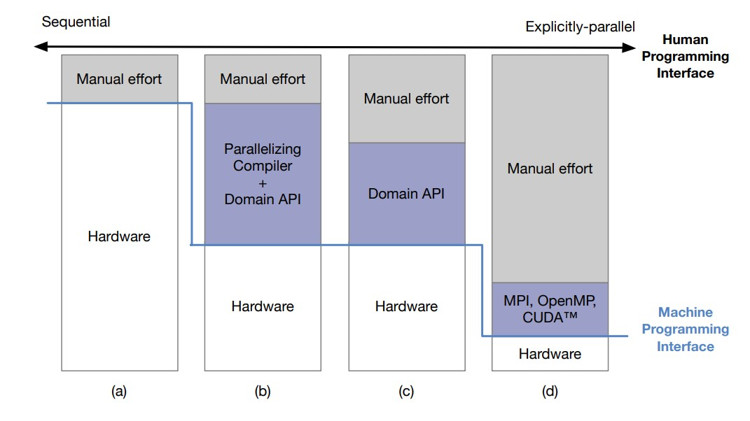
Levels of Parallel Programming Models

Slide 14
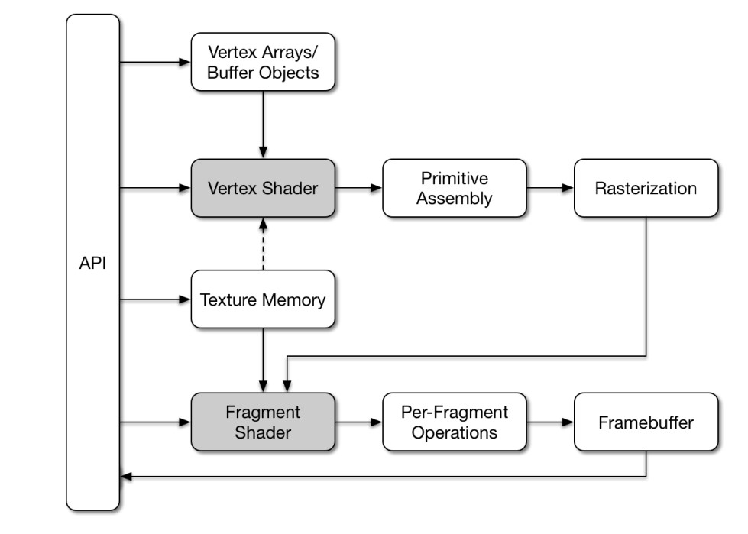
OpenGL ES

Slide 15
Apple Metal
Google Renderscript
Parallel Image Processing on Mobile Systems

Slide 16
Discussion

Slide 17
“This literature review revealed important knowledge on the state of research of parallel computation on mobile platforms and PMDs. In this paper, there is a good amount of studies on various, generic topics that provide important knowledge of parallel computation properties in those contexts”

Slide 18
Conclusion

Slide 19
Parallel computation is a mainstay in Computer Science and Software Engineering. In many areas of scientific and personal computing, the increased computation performance will come through progressions in parallelism.
In future research, will look into constructive research of image processing and video rendering using parallel computation by implanting different processor architectures on Linux, Windows, macOS, IOS, and Android platforms. And also include the answer on how meaningful are the efforts put into parallel programming solutions available

Slide 20


Slide 21


